Slide 1
Anxiety: How much is too much?
Kyle T. Ganson, MSW, LCSW, LICSW
Christine V. Rogerson, MSW, LCSW

Slide 2
Purpose
This interactive presentation is focused on understanding adolescent anxiety. Attention will be given to understanding what is “normal” and what is “too much”. Caregiver strategies supporting adolescent anxiety management, as well as promoting resiliency will be shared.

Slide 3
Progressive Muscle Relaxation
Activity

Slide 4
Anxiety Definition
A. Excessive anxiety and worry (apprehensive expectation), occurring more days than not for at least 6 months, about a number of events or activities (such as work or school performance).
B. The individual finds it difficult to control the worry.
APA, 2013

Slide 5
Anxiety Definition
C. The anxiety and worry are associated with three (or more) of the following six symptoms (with at least some symptoms having been present for more days than not for the past 6 months): Note: Only one item is required in children.
Restlessness or feeling keyed up or on edge.
Being easily fatigued.
Difficulty concentrating or mind going blank.
Irritability.
Muscle tension.
Sleep disturbance (difficulty falling or staying asleep, or restless, unsatisfying sleep).
APA, 2013

Slide 6
Anxiety Definition
D. The anxiety, worry, or physical symptoms cause clinically significant distress or impairment in social, occupational, or other important areas of functioning.
There are other anxiety disorders:
Panic Disorder
Phobia-Related Disorders
Social Anxiety Disorder*
Separation Anxiety*
Obsessive-Compulsive Disorder*
APA, 2013

Slide 7
Statistics
15-20% of children and adolescents experience an anxiety disorder (Kessler et al., 2012; Merikangas et al., 2010) - Most common mental illness Females: 2x more likely to develop an anxiety disorder (Beesdo et al., 2009)
Commonly associated with:
Depression
Behavioral Disorders (Lewinsohn et al., 1997)
Substance Use (Ohannessian, 2014)
Predicts adulthood anxiety, depression, and substance use (Beesdo-Baum et al. 2012)

Slide 8
Impact of Anxiety
Avoidance
Poor Listening Skills
Impact of Anxiety
Decreased academic achievement (Van Ameringen, 2003)
Difficulty with friendships and family relationships
Irrational Thinking
Anger
Frustration
Low Self-Esteem
Difficulty Concentrating

Slide 9
Anxiety: What is normal? Too much?
In your groups, make a list of what might be “normal” anxiety for your child or adolescent.
Next, make a list of what might be “too much” anxiety for your child or adolescent.

Slide 10
What Causes Anxiety?
Ongoing Stress
Environmental Factors
Relationship Factors
Expectations are too high
Acute Stress
Traumatic Situations (Medically related, Environmentally related)
www.medicalnewstoday.com
Notes:
CHRISTINE

Slide 11
Other Causes of Anxiety to Watch Out For:
Too much caffeine
Substance use
Diet pills
Medication side effects
Medical Conditions
www.everydayhealth.com
Notes:
CHRISTINE

Slide 12
Our Body’s Response
The Stress Response (Fight or Flight Response)
Our bodies are designed for protection.
The nervous system and endocrine systems respond to stressful situations by releasing hormones (adrenaline, cortisol, norepinephrine & others)
Notes:
CHRISTINE

Slide 13
Our Body’s Response (Cont.)
This causes:
More energy Heightened awareness Heart rate
Heightened reactions Changes breathing
Tightens muscles Changes brain functioning
Changes digestion
https://www.anxietycentre.com
Notes:
CHRISTINE
These things are all normal

Slide 14
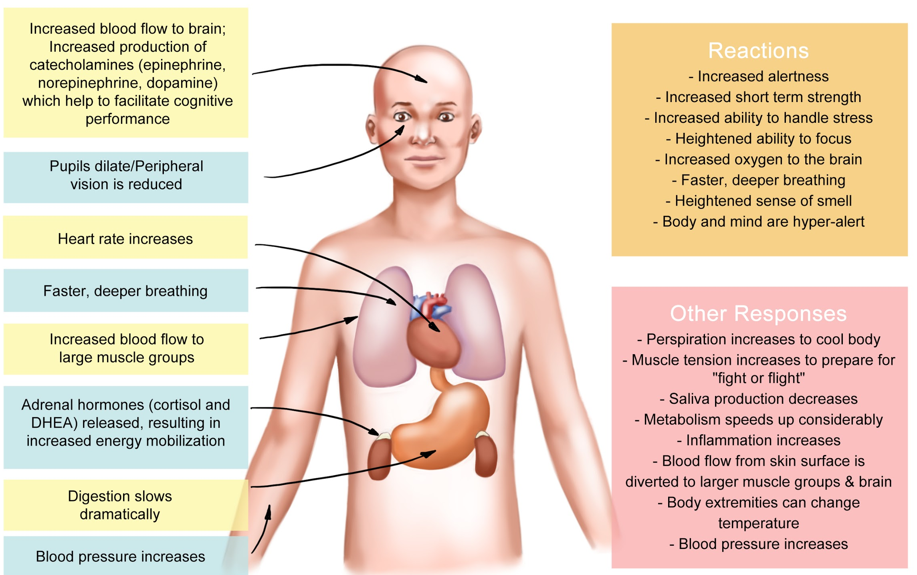
Notes:
CHRISTINE
These things are all normal

Slide 15
A Little Bit is Ok, Too Much is Not
Having this autonomic response can sometimes be helpful
Increase ability to perform
Increase motivation
Increase “confidence”
Get out of danger or react to an event
Notes:
CHRISTINE

Slide 16
Prolonged Exposure
When someone is exposed to a situation or event the body will react
The more someone is exposed to same situations that cause autonomic responses, the more the body is taught to respond in that manner (even when not in danger)
Notes:
CHRISTINE

Slide 17
What About Genetics?
Some people are more prone to anxiety and anxiety disorders
They have a genetic component just like other health conditions
Some personality types are more prone as well
www.adaa.org
Notes:
CHRISTINE

Slide 18
CDC: ACES What are They?
Adverse Childhood Experiences
Abuse, Neglect, Life Challenges (divorce, relatives incarcerated, relatives with substance use etc)
Increase risk of:
Risky Health Behavior
Chronic Health Conditions
Low Life Potential
Early Death
Risk can be changed! ACES HANDOUT
https://www.cdc.gov/violenceprevention/acestudy/about_ace.html
Notes:
CHRISTINE

Slide 19
Coping Skills for Children and Adolescents
Activities
5 Senses
Challenge All or Nothing Thinking (CBT)
Sensory Box

Slide 20
What is Your Role?
Pay attention to your child’s feelings.
Stay calm when your child becomes anxious about a situation or event.
Recognize and praise small accomplishments.
Don’t punish mistakes or lack of progress.
Be flexible, but try to maintain a normal routine.
Modify expectations during stressful periods.
Plan for transitions (For example, allow extra time in the morning if getting to school is difficult).
Work together as parents.
Maintain consequences
Adaa.org & worrywisekids.org

Slide 21
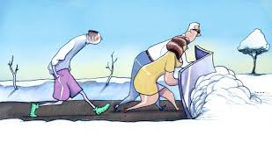

Slide 22
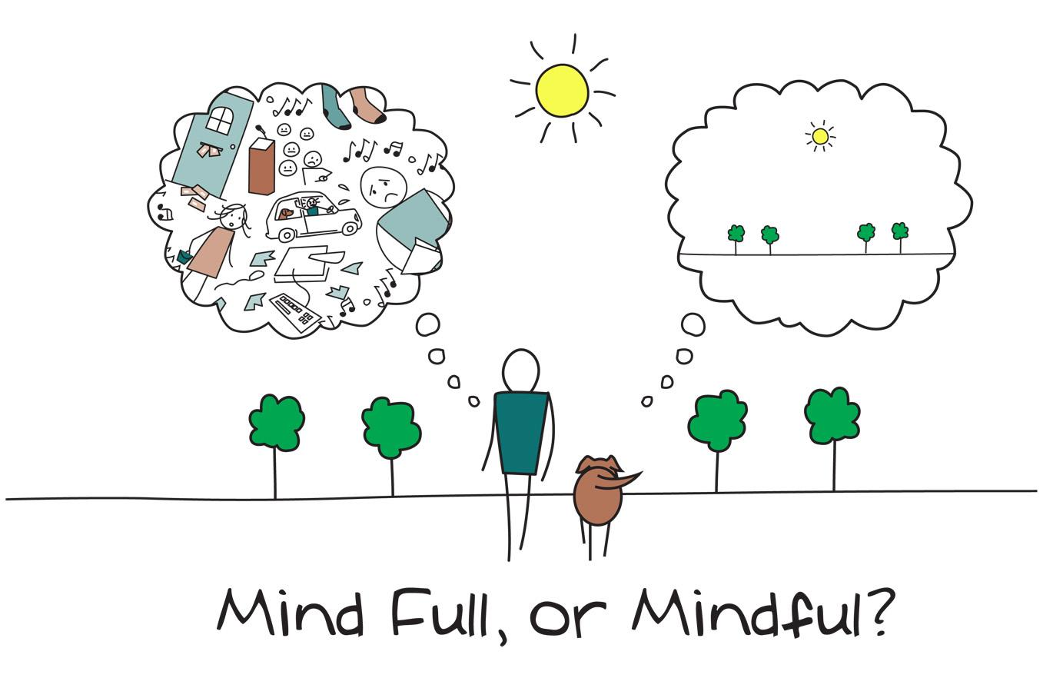

Slide 23
When Anxiety is too much….
Reach out to your support natural or professional
Professional supports may include: School counselor, local therapist (this does not mean you have failed)
Encourage your children to engage in healthy activities they enjoy
Open communication lines
Support your child
No secrets

